Slide 1


14/11 2019
Transforming
Collaborative
Product
Creation.

Slide 2
Agenda
> Introduction
> Point 1.1
> Point 3
> What’s new?
> Lunch > End

Slide 3
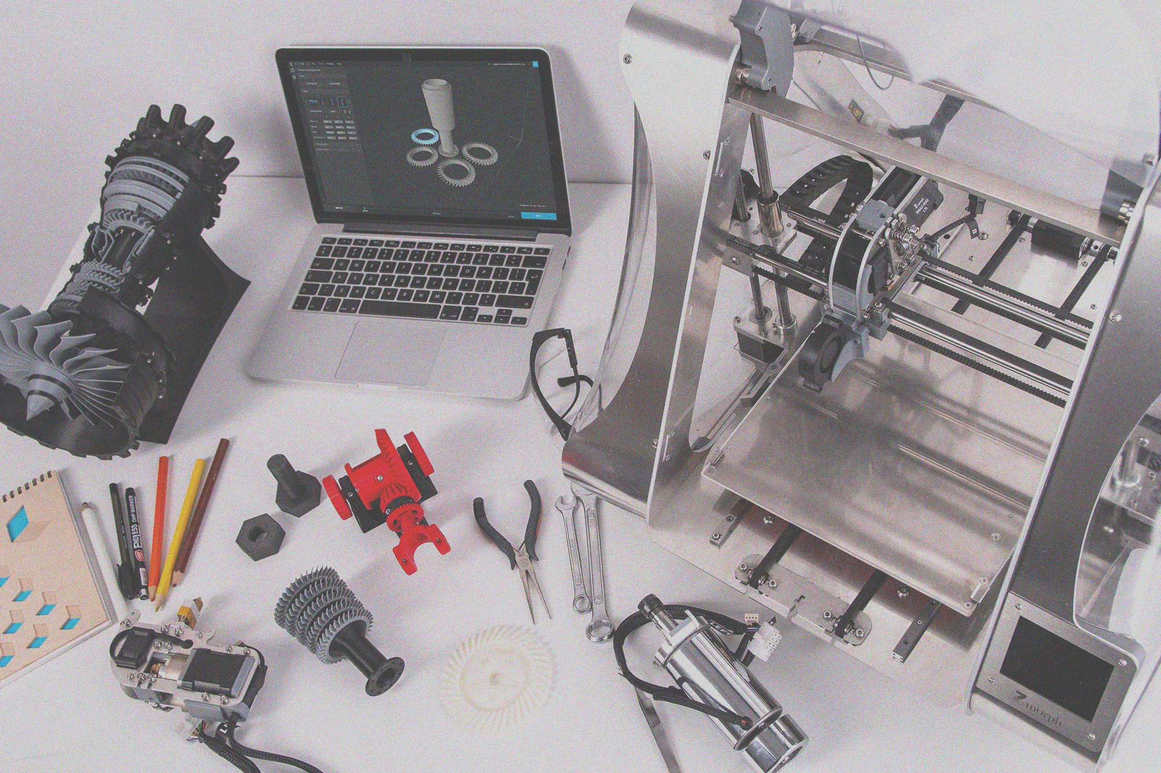

Slide 4
“
We are trying to create the internet of product creation.

Slide 5
Project goals ↴
1.
Wider adoption of Open Source Hardware.
2.
Enable fablabs to support companies.
3.
Provide IT solutions for OSH development.
4.
Document OSH journeys of 18 SMVs.

Slide 6
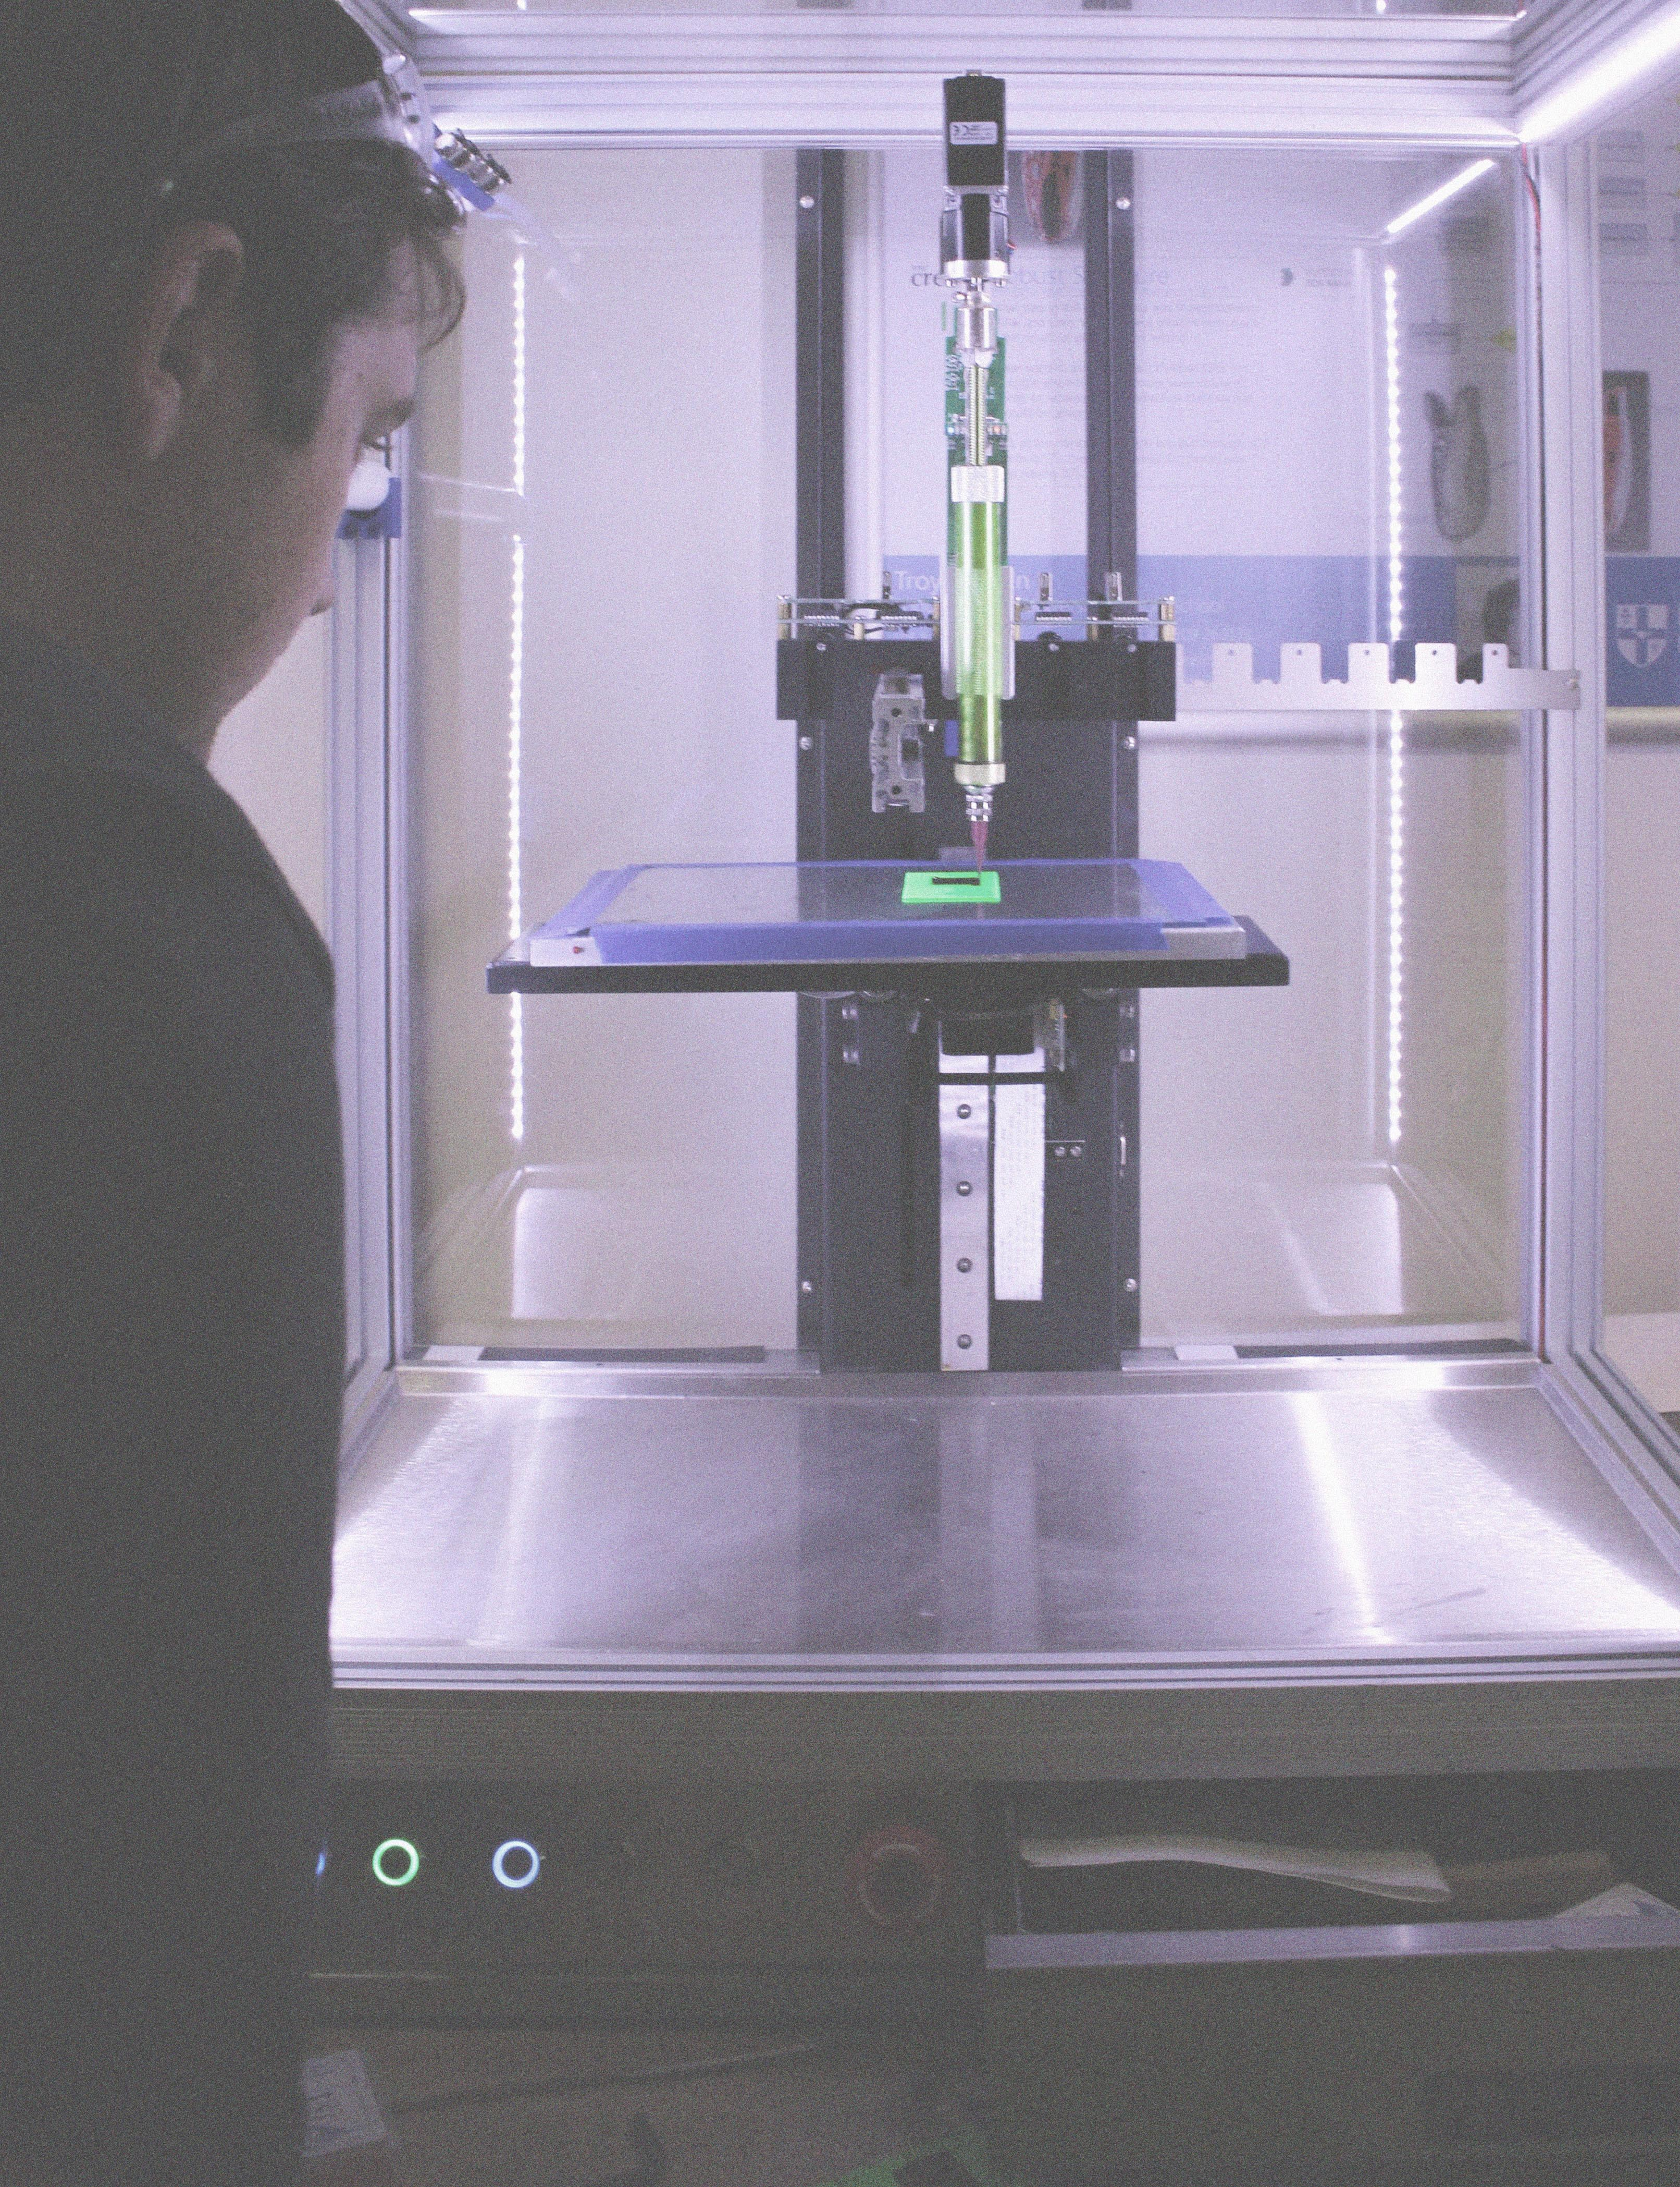

Slide 7

Background
Open source software (OSS) gave rise to a billion-euro economy. Open Source Hardware (OSH) is a recent and promising extension of open source practices to the creation of physical objects.
OPEN!NEXT focuses on encouraging and supporting small medium enterprises (SMEs) to unleash OSH’s potential through engagement in collaborative open design of products and services together with fab labs/makerspaces.

